Slide 1


KILR Tech project presentation on Media Bazaar’s software solution

Slide 2
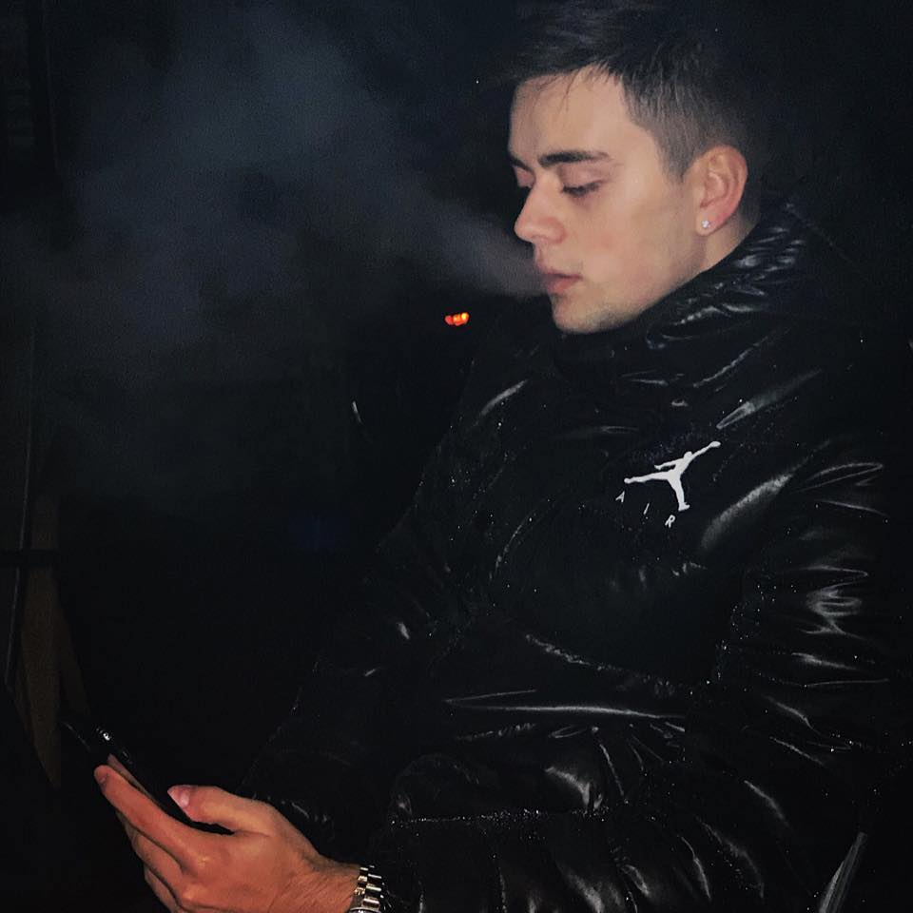
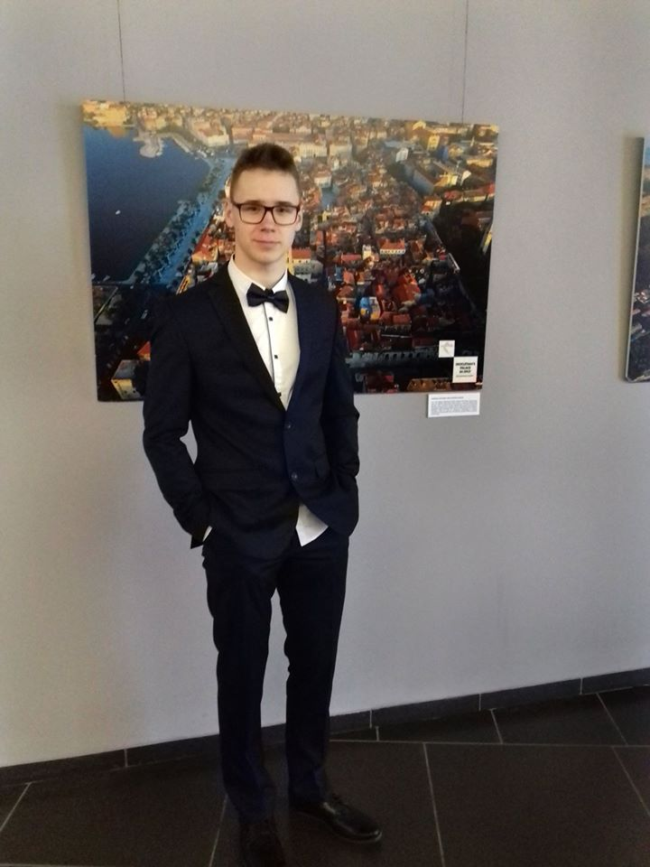
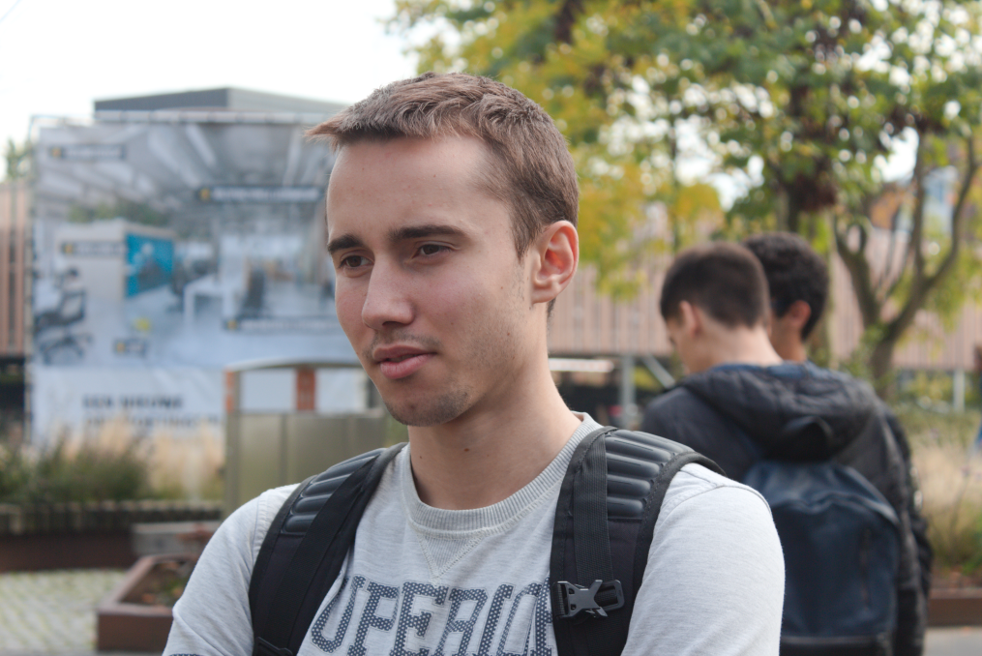
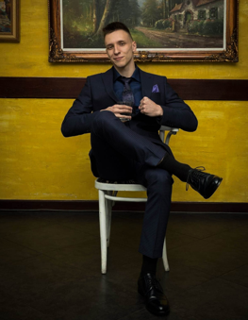
Team Members
Radoslav Karaganchev
Lukas Rimavičius
Ivan Marinchev
Kristian Lachev

Slide 3
Why you should choose us?
User friendliness
Good working ethic
Provided solutions to the company’s problems

Slide 4
Department
Creation
Edit
Removing
Including employees/removing employees
User friendliness

Slide 5
Employee
Creation
Edit
Removing
Filtering
Insert/remove from departments
User friendliness

Slide 6
Stock
View
Create
Remove
Edit
Filter

Slide 7
Thank you for your attention
Questions?

